Slide 1
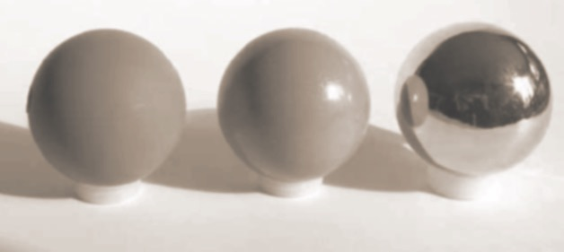
The perception of surface material from disparity and focus cues
Martin S. Banks¹, Abdullah Bulbul¹, Rachel Albert¹, Joohwan Kim^{1,} Rahul Narain², James F. O’Brien², & Gregory J. Ward³
¹ Vision Science Graduate Program, UC Berkeley
² Department of Computer Science, UC Berkeley
³ Lawrence Berkeley National Laboratory & Dolby Labs
Notes:
Distinguishing materials based on their visual properties is invaluable. Distinguishing good from spoiled meat or fish. Determining the quality of the finish of an automobile or fabric. Or determining whether a surface is safe to walk on (is it solid or mushy?).

Slide 2
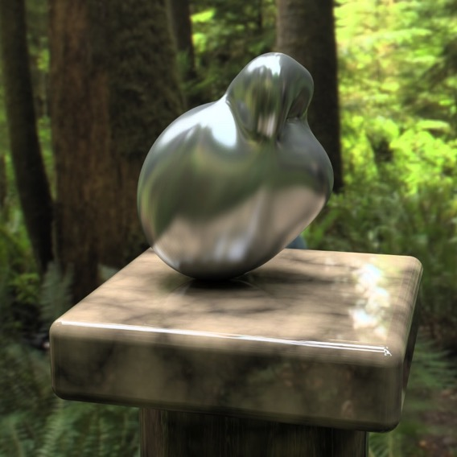
Inferring Material Properties
Retinal image determined by:
  properties of surrounding environment
  surface geometry
  viewer’s position
  surface reflectance properties
Determining surface material greatly under-constrained
Notes:
The problem is that the visual appearance of a surface is determined by many factors including the properties of the illuminant, the geometry of the surface, the viewer’s position, and of course the reflecting properties of the material itself. Because of this identical materials can create quite different retinal images. Similarly, very different materials can create rather similar images.

Slide 3
Inferring Material Properties
Image statistics
  highlights are bright & desaturated
  skew of luminance histogram (Motoyoshi et al., 2007)
  curvature flow (Fleming, 2014)
Notes:
Change 2, get the same image

Slide 4
Inferring Material Properties
Image statistics
  highlights are bright & desaturated
  skew of luminance histogram (Motoyoshi et al., 2007)
  curvature flow (Fleming, 2014)
Natural viewing
  binocular
  motion
  accommodation & blur
Notes:
Great majority of studies in vision science literature use pictures of objects composed of different materials. People are reasonably good at categorizing materials despite impoverished viewing condition. Here we consider the additional information provided by binocular viewing when either the object or viewer might be moving. And importantly, how accommodation (focusing the eye to different distances) coupled with blur can help distinguish material properties.

Slide 5
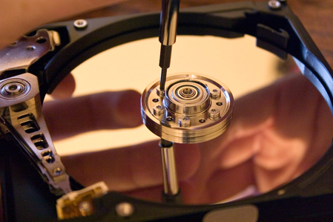

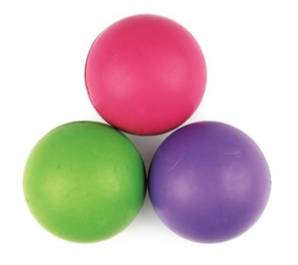
Reflections from Different Materials
specular
Lambertian
complex

Slide 6
Reflections from Different Materials
specular
Lambertian
complex
Bidirectional Reflectance Distribution Function (BRDF)

Slide 7
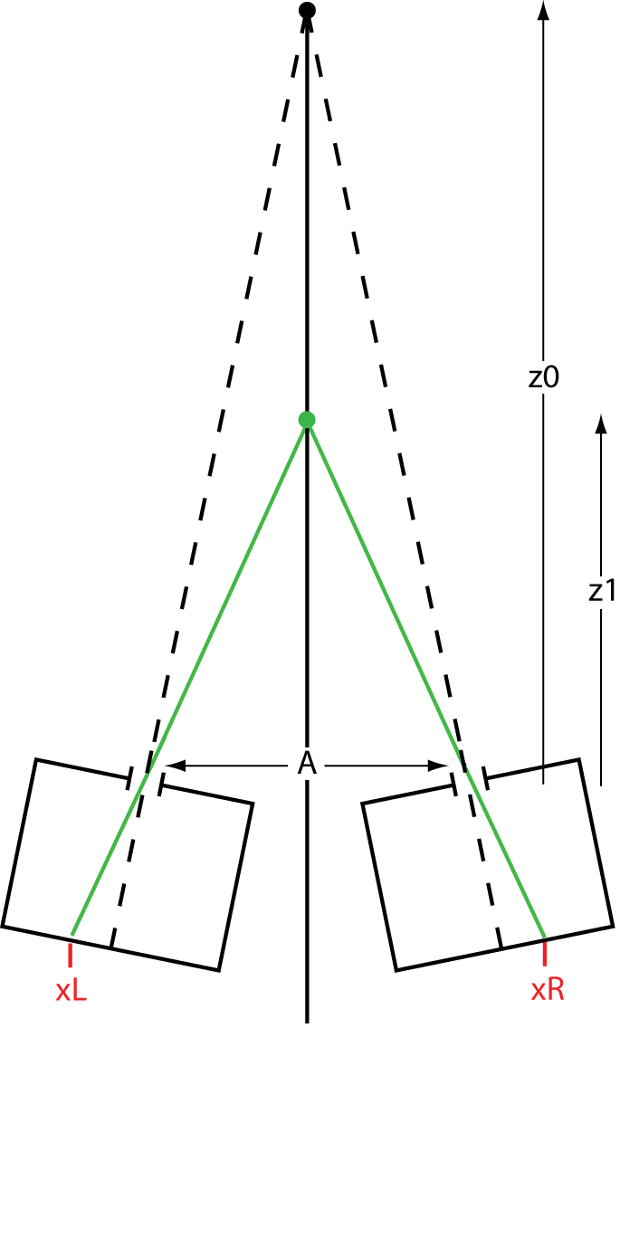
Binocular Disparity
z₀
where
z₁
I
left eye
right eye
s₀
in radians
X_{L}
X_{R}
Held, Cooper, O’Brien, & Banks (2010)

Slide 8
Focus & Blur
z₀
z₁
A
s₀
in radians
b₁
Held, Cooper, O’Brien, & Banks (2010)

Slide 9
Triangulation Cues to Depth
binocular disparity
z₀
motion parallax
z₁
baseline
blur
X_{L}
X_{R}

Slide 10
Reflection Geometry: Disparity
illumination sphere
object
virtual image
left & right eyes
left & right eyes
Kirschmann (1895)
Blake & Bülthoff (1990)
Muryy, Fleming, & Welchman (2013)

Slide 11
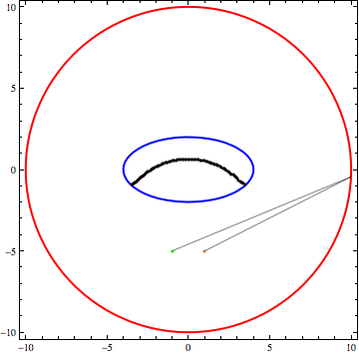
Reflection Geometry: Disparity
illumination sphere
object
virtual image
left & right eyes
Kirschmann (1895)
Blake & Bülthoff (1990)
Muryy, Fleming, & Welchman (2013)

Slide 12
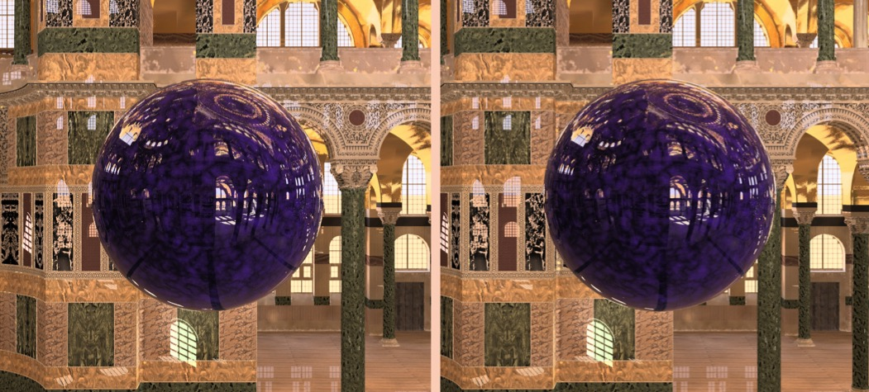
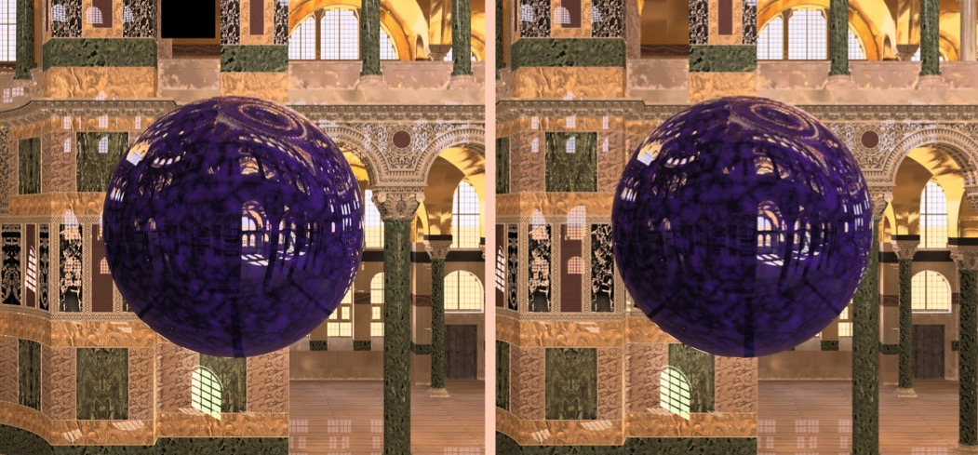
Reflections & Disparity
Reflection:
virtual image with uncrossed disparity
Paint: same highlight with zero disparity

Slide 13
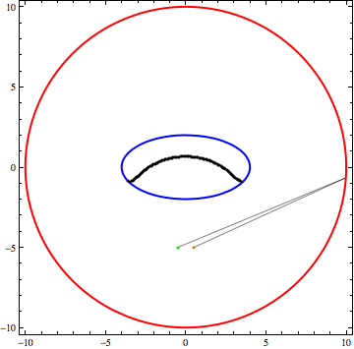
Reflection Geometry: Blur
illumination sphere
object
virtual image
pupil aperture

Slide 14
Reflection Geometry: Blur
illumination sphere
object
virtual image
pupil aperture

Slide 15
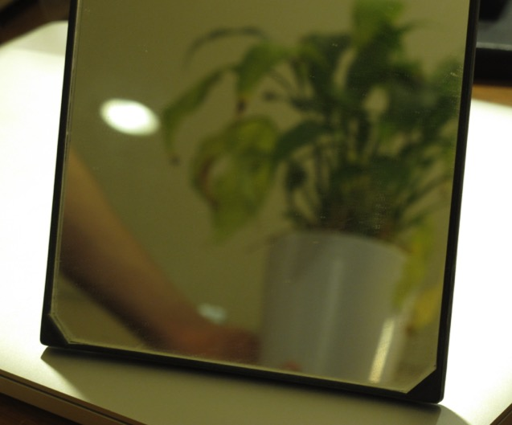
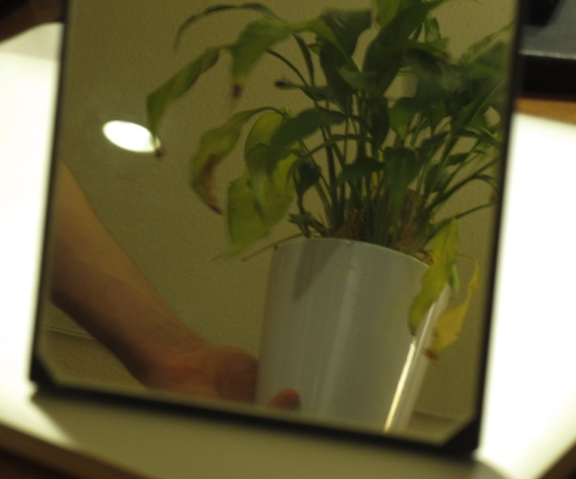
Reflections & Blur
focus on surface
focus on reflection

Slide 16
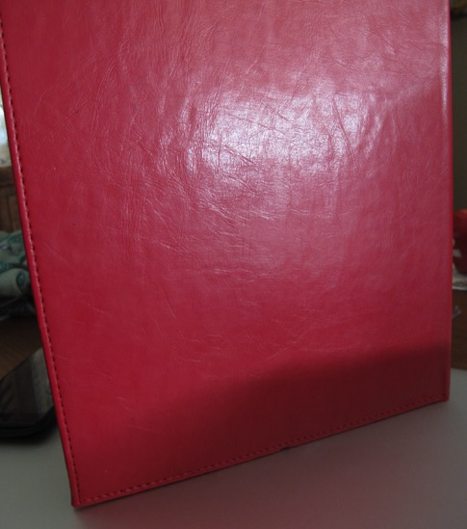
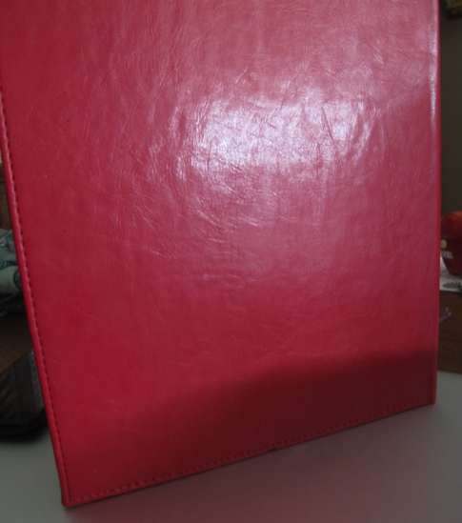
Reflections & Blur
focus on surface
focus on reflection

Slide 17
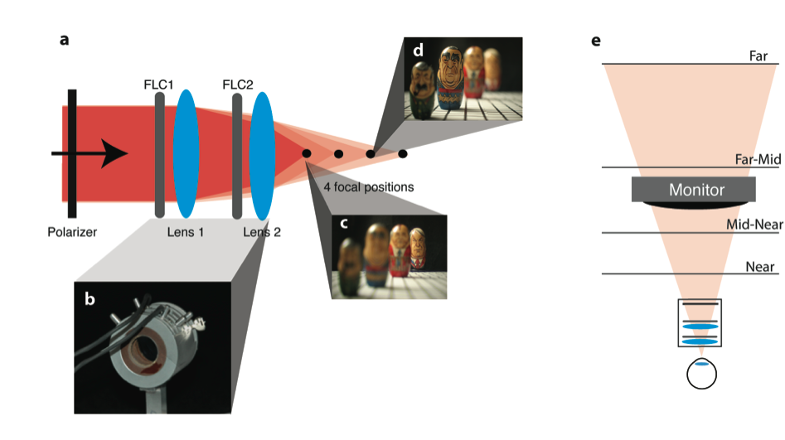
      Multi-plane Display
Do vergence-accommodation conflicts in stereo displays cause discomfort & fatigue?
If so, what can we do to minimize the discomfort & fatigue?
Love, Hoffman, Hands, Gao, Kirby, & Banks (2009)

Slide 18
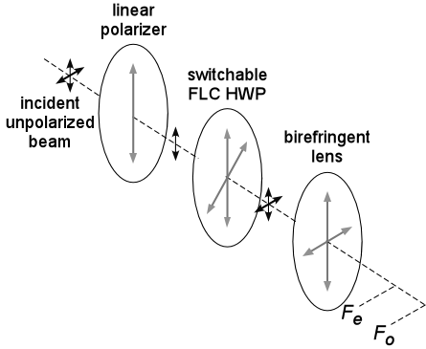
Switchable Lens
Birefringent material (e.g., calcite) has ordinary & extra-ordinary refractive indices depending on polarization
Calcite lens has two focal lengths F_{o} & F_{e}
Variation in power effected by polarization modulator (FLC)
Can stack lenses; 2^{N} states
Love, Hoffman, Hands, Gao, Kirby, & Banks (2009)

Slide 19
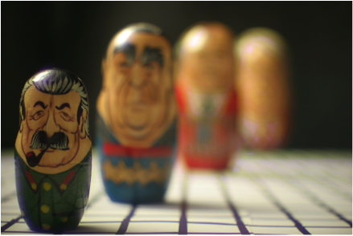
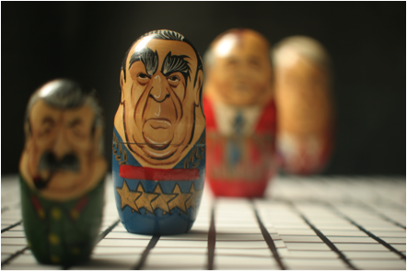
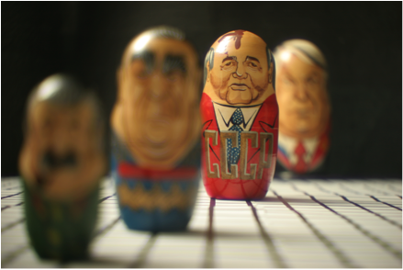
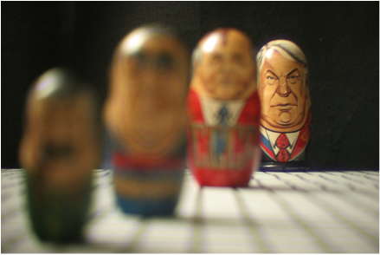
      Changing Focal Distance
lens in near state
lens in near-mid state
lens in mid-far state
lens in far state
Love, Hoffman, Hands, Gao, Kirby, & Banks (2009)

Slide 20
      Multi-plane Display
Love, Hoffman, Hands, Gao, Kirby, & Banks (2009)

Slide 21


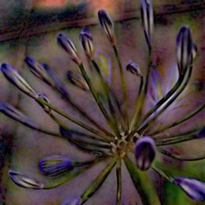
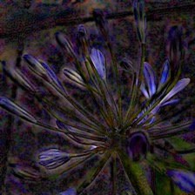
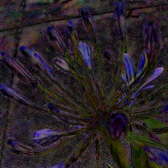
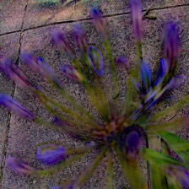
Optimized Blending
s_{i}
s_{i}ʹ
=
k_{i1} ∗
p₁
+
k_{i2} ∗
p₂
+
k_{i3} ∗
p₃
+
k_{i4} ∗
p₄

Slide 22
Optimized Blending
s_{i}
s_{i}ʹ
=
k_{i1} ∗
p₁
+
k_{i2} ∗
p₂
+
k_{i3} ∗
p₃
+
k_{i4} ∗
p₄

Slide 23
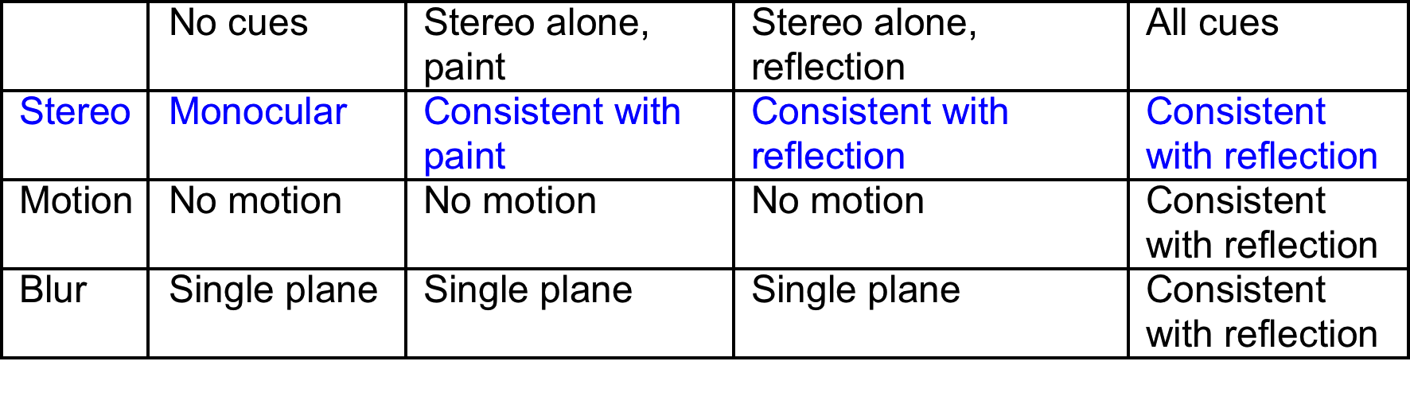
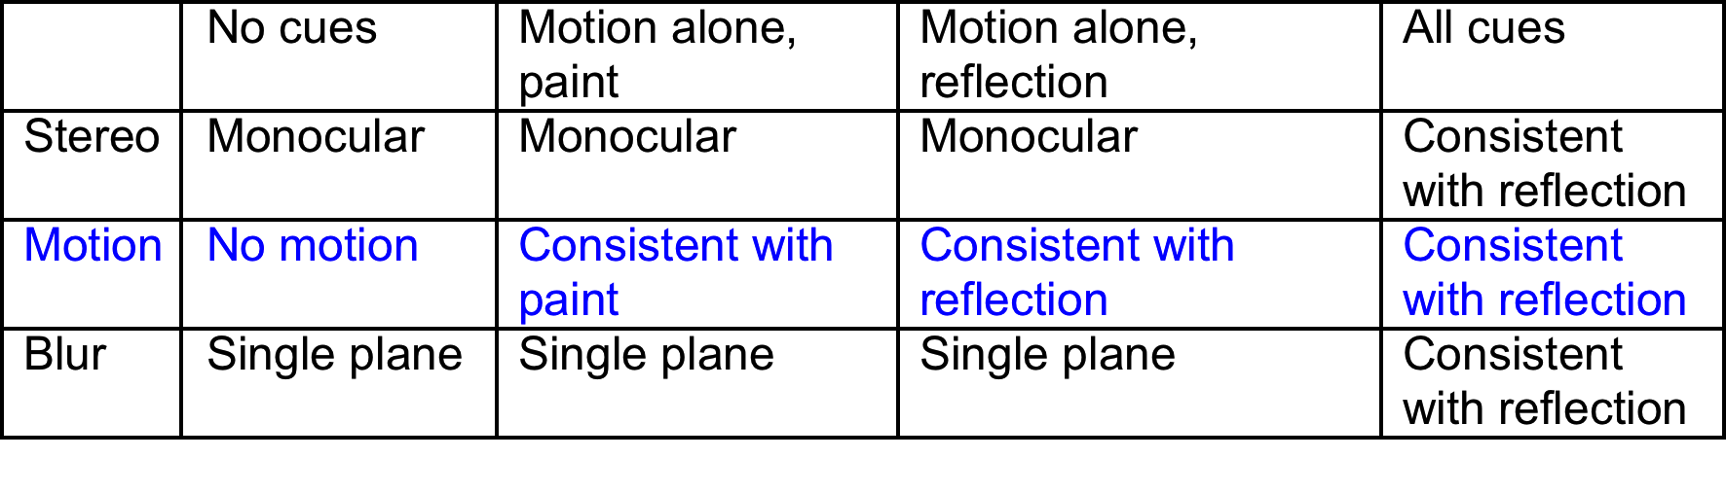
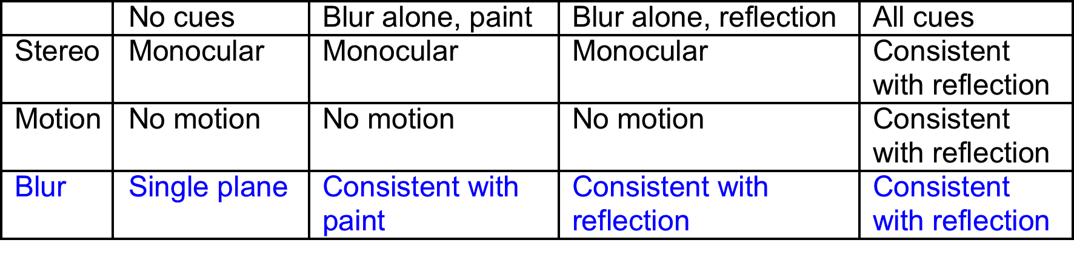
Stimulus Conditions
Stereo
Motion
Blur

Slide 24
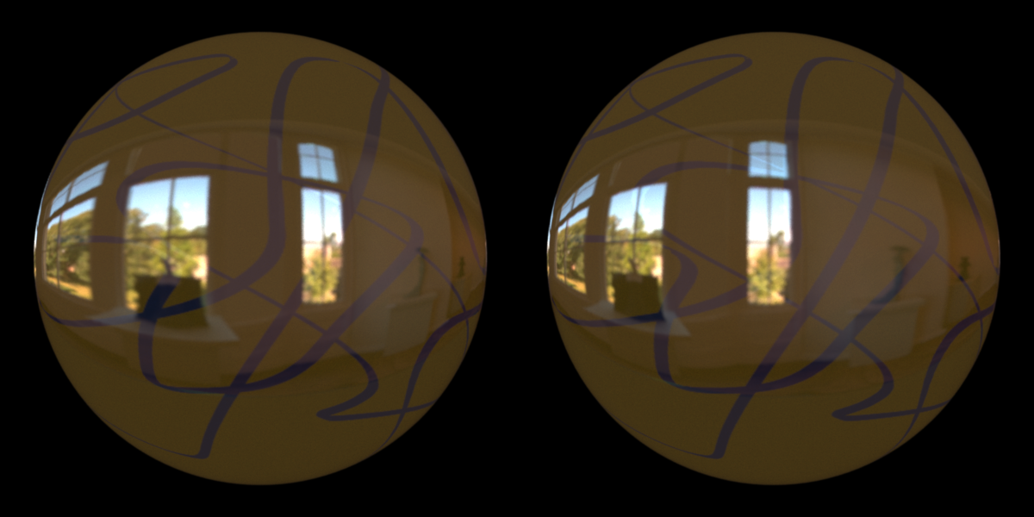
Experimental Stimulus: Stereo
reflection
Notes:
Is this pinhole rendering?

Slide 25
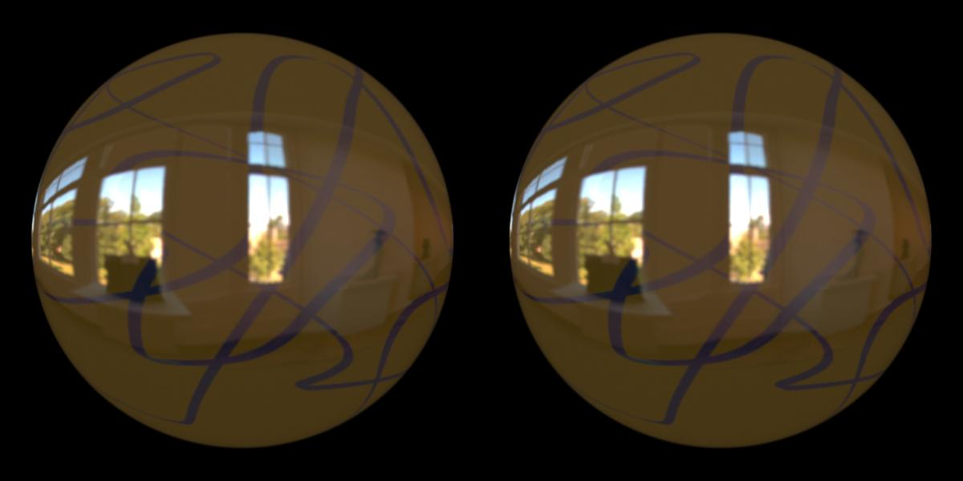
Experimental Stimulus: Stereo
paint
Notes:
Is this pinhole rendering?

Slide 26
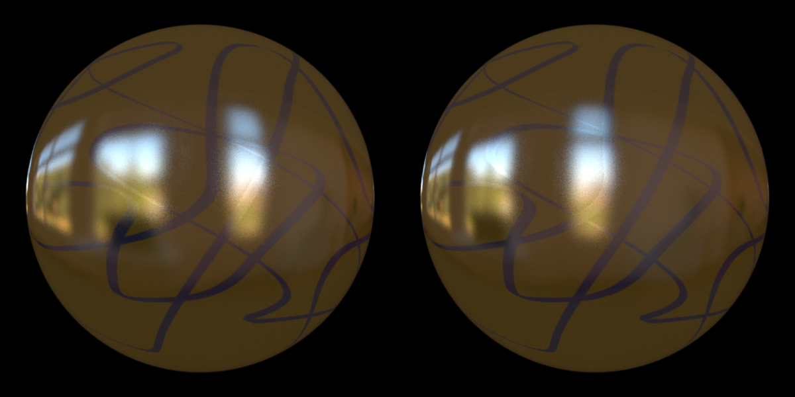
Experimental Stimulus: Stereo
reflection
Notes:
Is this pinhole rendering?

Slide 27
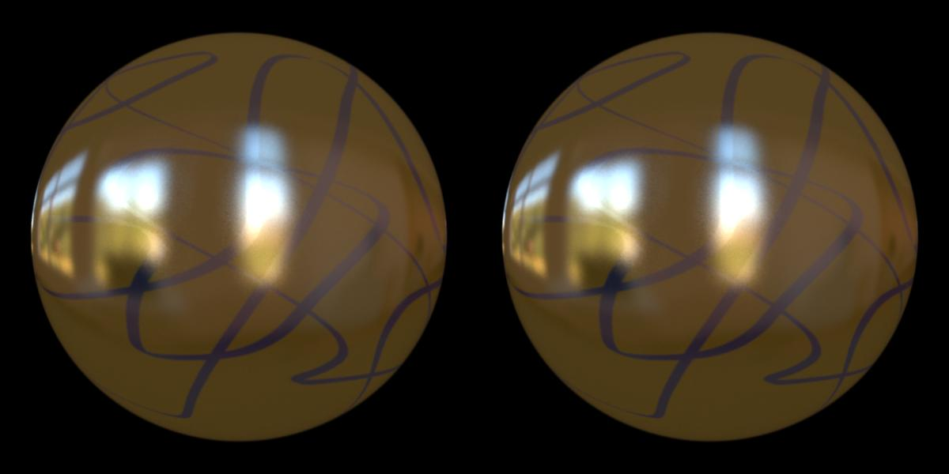
Experimental Stimulus: Stereo
paint
Notes:
Is this pinhole rendering?

Slide 28
Stimulus Conditions
Stereo
Motion
Blur

Slide 29
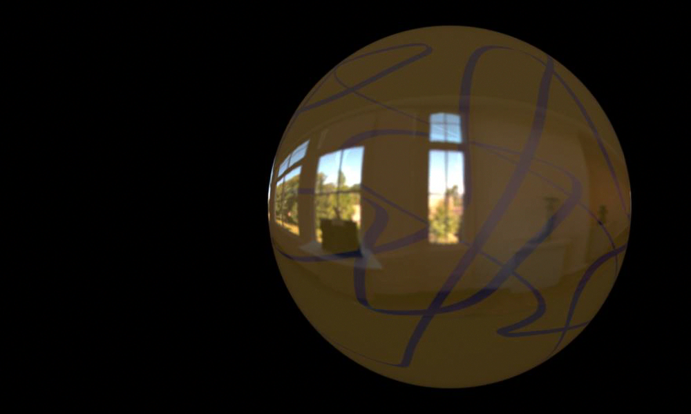
Experimental Stimulus: Motion Parallax
reflection
Notes:
Is this pinhole rendering?

Slide 30
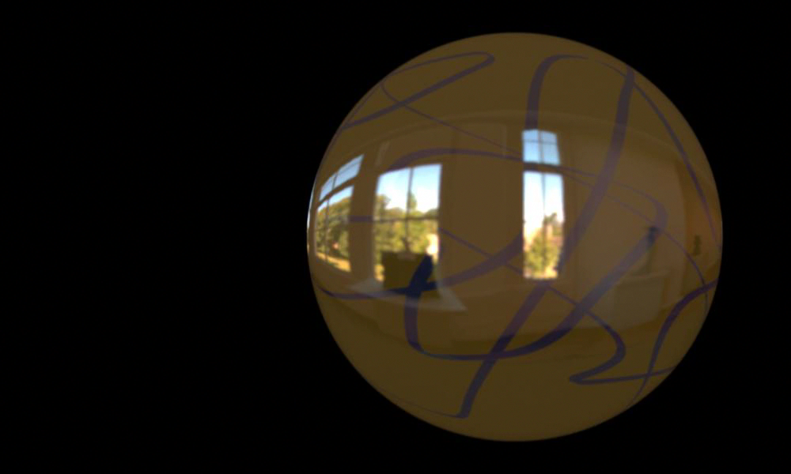
Experimental Stimulus: Motion Parallax
paint
Notes:
Is this pinhole rendering?

Slide 31
Stimulus Conditions
Stereo
Motion
Blur

Slide 32
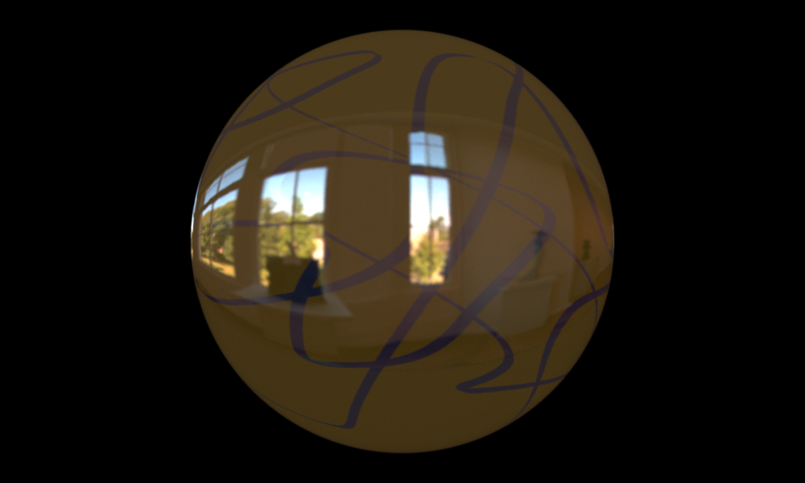
Experimental Stimulus: Volumetric
camera focused on surface

Slide 33

Experimental Stimulus: Volumetric
camera focused on reflection

Slide 34
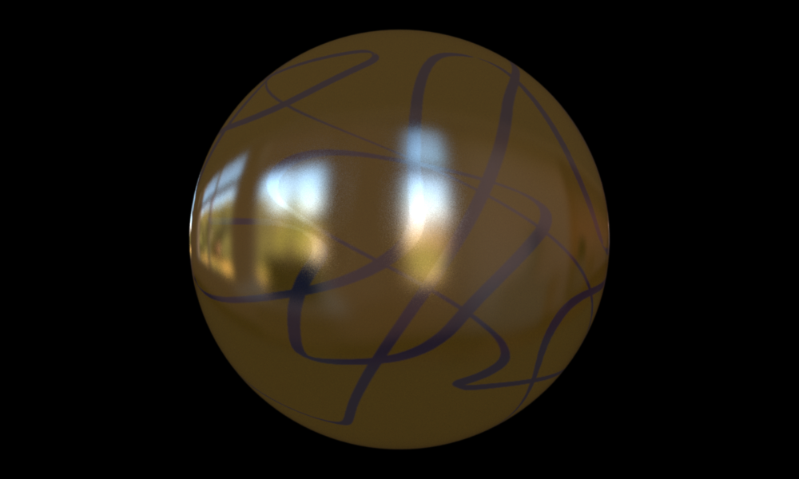
Experimental Stimulus: Volumetric
camera focused on surface

Slide 35

Experimental Stimulus: Volumetric
camera focused on reflection

Slide 36
Experimental Procedure
Stimuli
textured flattened ovoids; four different textures
material rendered according to Ward’s isotropic BRDF model
  specular reflection or slightly rough specular
  Lambertian analog to both
distant environment map for illumination
duration = 4 sec
Response measure
subjects indicate perceived glossiness of each stimulus on 0-9 scale
15-min training session with no feedback to anchor scale
Subjects
four young adults with corrected-to-normal acuity (three naïve)
264 observations per subject (12 presentations of 22 conditions)

Slide 37
Results: Disparity
Notes:
No cues yielded slightly higher gloss rating than stereo on surface

Slide 38
Results: Disparity
Sakano & Ando (2010)
Wendt, Faul, Ekroll, & Mausfeld (2010)
Notes:
No cues yielded slightly higher gloss rating than stereo on surface

Slide 39
Results: Motion Parallax

Slide 40
Results: Motion Parallax
Sakano & Ando (2010)
Doerschner et al. (2011)

Slide 41
Results: Blur
Notes:
No cue had slightly higher gloss rating than single-plane with blur, but lower than volumetric.

Slide 42
Average Results: Roughness = 0
Disparity
Motion parallax
Blur
**
**
**
**
**
**
Wilcoxon signed-rank test
**
p < 0.01

Slide 43
Average Results: Roughness = 0.01
Disparity
Motion parallax
Blur
**
n.s.
n.s.
**
**
n.s.
Wilcoxon signed-rank test
**
p < 0.01
n.s. not significant

Slide 44
Conclusions
Reflections from specular surfaces with smooth geometry create virtual reflection images distinguishable from the surface by disparity, motion parallax, & blur.
Humans use each of those reflection cues—in isolation and in combination—to estimate surface gloss. The novel observation is that blur is used.
When surface material is rough, virtual reflection images become less distinct.
Pinhole rendering of reflections, which is commonplace, is inappropriate because humans use focus cues to estimate gloss.
Funding from NSF & NIH

Slide 45
Motion Parallax
z₀
z₁
M
in radians
time 1
time 2
s₀
X_{L}
X_{R}

Slide 46
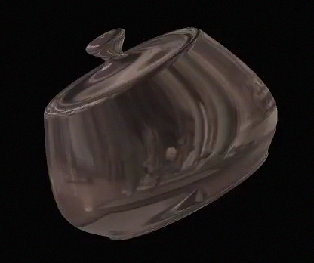
Motion Parallax
Hartung & Kersten (2002)

Slide 47
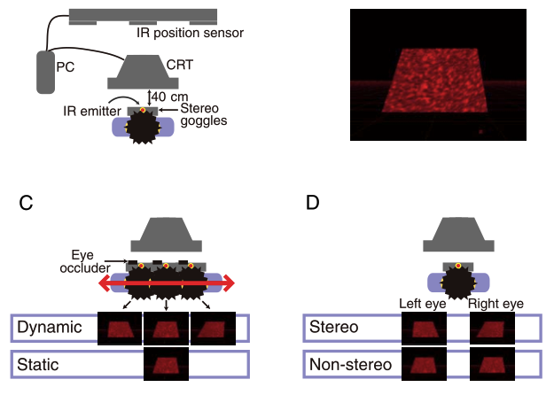
Previous work on triangulation cues and material perception
Perception of gloss is enhanced by
  Changes in illumination with observer motion
  Differences between the two eyes in the luminance of an area
No previous work on blur and material perception
Sakano & Ando
(JOV, 2010)

Slide 48
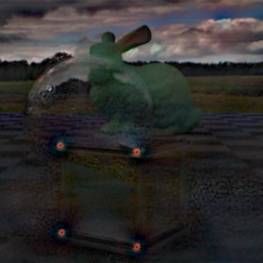
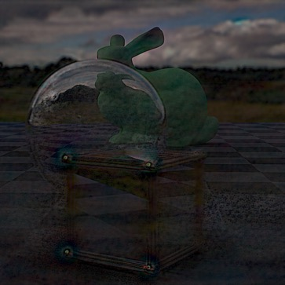
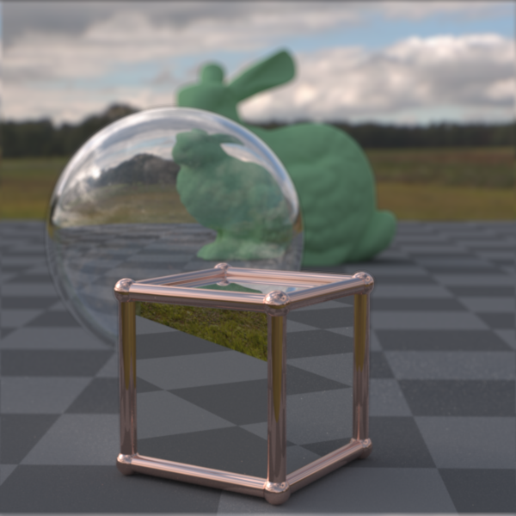
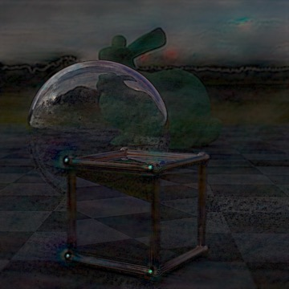
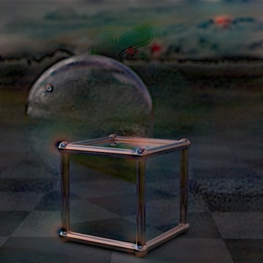
Example layers
(optimized blending)
Layers
Original scene
far
far-mid
mid-near
near
Courtesy of Rahul Narain

Slide 49
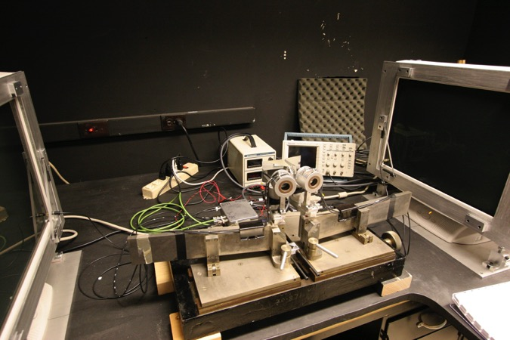
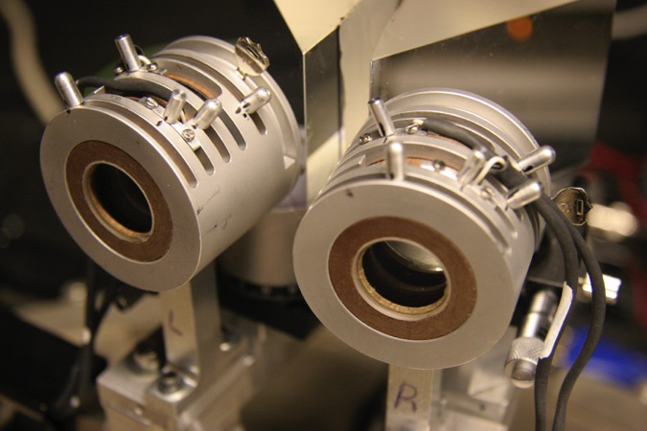
      Two-monitor Configuration
4 focal powers separated by 0.6 diopters
workspace of 1.8 diopters; insertion of ophthalmic lenses allows adjustment
monitor & lens refresh of 180 Hz, so 45 Hz per eye per lens state
field of view of ~15 deg
Love, Hoffman, Hands, Gao, Kirby, & Banks (2009), Optics Express

Slide 50
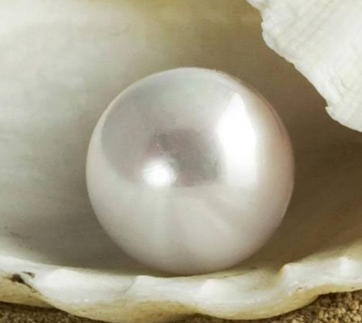

Complex materials
Pearl: Glossy
Rubber: Matte

Slide 51
Reflection Geometry
Kirschmann (1895)
Blake & Bülthoff (1990)
Muryy, Fleming, & Welchman (2013)

Slide 52
      Schematic of Lens
Do vergence-accommodation conflicts in stereo displays cause discomfort & fatigue?
If so, what can we do to minimize the discomfort & fatigue?
Love, Hoffman, Hands, Gao, Kirby, & Banks (2009)

Slide 53
Optimization: in words (for Marty's benefit)
The input is a set of target images focused at different depths. The unknowns are the images to display on the presentation planes such that the result matches these target images.
Consider one of the target images, focused at a known depth. When the viewer focuses on that depth in the volumetric display, the image on each presentation plane is blurred by a known PSF. The resulting image seen by the viewer is the sum of these blurred images. We want this image to be the same as the target image.
We can compute a measure of error between the target image and the viewed image. We seek to minimize the total squared error across all target focus depths, as long as the presentation images remain within the displayable range.

Slide 54

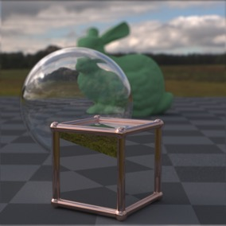
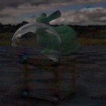
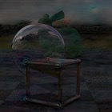

Optimized blending technique
The layers are calculated such that their sum approximates the original scene

Slide 55
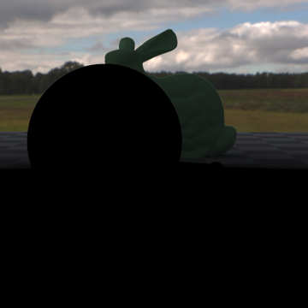
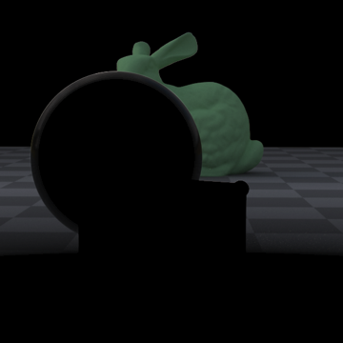
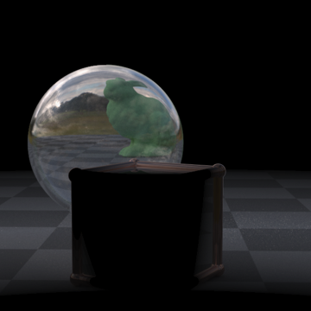

Example layers
(linear blending)
Layers
Original scene
far
far-mid
mid-near
near
Courtesy of Rahul Narain

Slide 56






Comparison of results
Linear Blending Technique
Optimization Technique

Slide 57








Linear Depth-weighted Blending
p₁
p₂
p₃
p₄
near focus
far focus

Slide 58

Reflection Geometry
Illumination sphere
object
virtual image

Slide 59







Optimized Blending
Input: target images
with different focus depths
s₁
· · ·
s_{n}
?
?
?
?
Unknown: images to display
on presentation planes
p₁
p₂
p₃
p₄
Notes:
The input is a set of target images focused at different depths. Unknowns are the images to display on the presentation planes such that the result matches these target images.
Consider one of the target images, focused at a known depth. When the viewer focuses on that depth in the volumetric display, the image on each presentation plane is blurred by a known PSF. The resulting image seen by the viewer is the sum of these blurred images. We want this image to be the same as the target image.
We compute a measure of error between the target image and the viewed image. We minimize the total squared error across all target focus depths, as long as the presentation images remain within the displayable range.

Slide 60

Experimental Stimulus: Motion Parallax
reflection
Notes:
Is this pinhole rendering?

Slide 61

Experimental Stimulus: Motion Parallax
paint
Notes:
Is this pinhole rendering?

Slide 62

Bidirectional Reflectance Distribution Function
I: incoming light
R: outgoing light
δ angle between normal and half angle between θ_{i} and θ_{r}
ρ_{d} diffuse reflectance
ρ_{s} specular reflectance
α standard deviation (RMS) of surface slope
Ward (1992)
Notes:
Check animations
Fix Hartung & Kersten
Check Wilcoxon title
Fix protocol slide

Slide 63








Optimized Blending
p₁
p₂
p₃
p₄
near focus
far focus

